Slide 1
The French and Indian War
How Britain’s Victory in the French
and Indian War Planted the Seeds for
the American Revolution

Slide 2
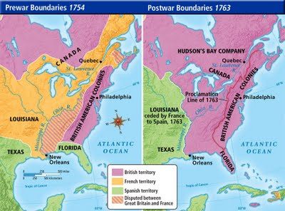
Before and After the War
What changed from 1754-1763? Why did it change?
Make an inference.

Slide 3
You might have noticed…
In 1754, there were 3 main powers in North America – Spain, England, and France.
Each of these countries was interested in North America’s rich resources and in accumulating new colonies to boost their economic and political power around the globe.

Slide 4
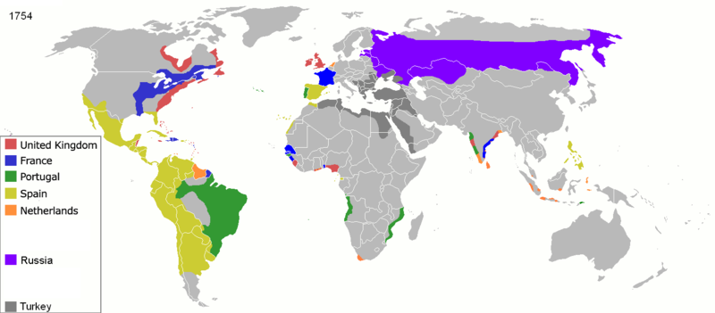
Colonization around the world
What do you notice about You can see below how much of the world was controlled by Spain, France and England?
Think-Pair-Share

Slide 5
You might also have noticed…
In 1754 Britain controlled the land on the east coast (the 13 colonies). France controlled a large portion of land in the middle of what would become the United States. Spain controlled what we know now as Florida, Texas, many islands, and Central and South America.

Slide 6
In 1763, things look different:
Britain and Spain both expanded the land they controlled – effectively splitting the land the French used to control.
France controlled the island of Haiti.
Turn and Talk: What can you infer happened?

Slide 7
Looking Back: The French and
Indian War
1754-1763

Slide 8
France versus England
Neither liked being colonial neighbors in North America. They distrusted each other and each wanted full control of the area.
1753
The French and the English were long-time enemies of each other, e.g., “The One Hundred Years War”
A bomb ready to go off…

Slide 9
An Overview of the War
In 1763 France decided to push into a contested area in the Ohio River Valley.
The British were offended that the French invaded land they had claimed.
Both sides built up troops. American Indians fought on both sides, though mostly for the French.

Slide 10
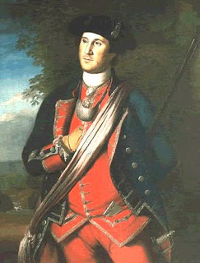
Seeing that a war was almost certain to occur, the King of France sent a peace delegation into the Ohio Valley.
Young George Washington was in his first major command of a British unit. He made a major mistake and ordered his men to fire on the party.

Slide 11
The American Indians
working with Washington
scalped several of the
Frenchman.
Now peace was impossible.

Slide 12
CONTENT Re-cap
Summarize how events escalated to the French and Indian War in your own words
Think-Pair-Share

Slide 13
How Britain Wins the war but loses everything…
Winning came at a great cost.
British national debt skyrockets
⁴³ Edmund S. Morgan and Helen M. Morgan, The Stamp Act Crisis: Prologue to Revolution (Chapel Hill, NC: The University of North Carolina Press, 1995), 21; Eric Foner, Give Me Liberty! An American History (New York: W. W. Norton, 2006), 151.

Slide 14

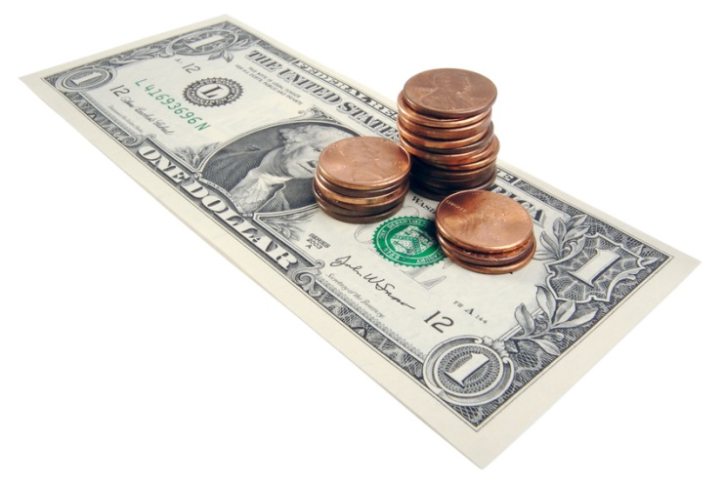
Cracking down on the colonies
Before the war, England generally ruled the colonies with a light touch.
They let the colonies set their own taxes, have their own colonial governments, and they turned a blind eye to Americans trading with other countries.

Slide 15

A new expectation
But now they felt the colonies owed them more respect and…money.
After all, they had invested in America and wanted (and needed) their money back.

Slide 16
New laws stun colonists
To gain additional money through trade →
  Crackdown on smuggling – new laws promise to inspect for goods shipped from other countries and send perpetrators of “smuggling” to jail
To gain additional money through taxes →
  New taxes are placed on Americans directly by the British parliament starting in 1764
To prevent costly war with American Indians and keep America from growing larger (and thus harder to control) →
  The Proclamation of 1763 prevents colonists from moving west of the Appalachian Mountains onto “Indian Territory”

Slide 17
Review the territory maps.
Summarize in your words, the results of the French and Indian War.
Pair-Share

Slide 18
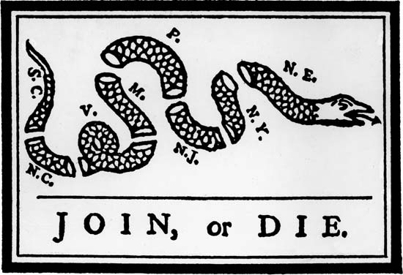
This cartoon was originally used during the French and Indian War to convince Americans to pull together and fight against the French. But suddenly, this cartoon had new meaning…

